Slide 2
Background
Start at the same time
Estimated Transport Time
Estimated Enumeration TIme
Finish almost at the same time

Slide 3
Background
Similar With
Multi Depot Vehicle Routing Problem
2
1
10
3
11
A
9
B
7
4
5
8
12
6

Slide 4
Background
Enumeration Time Cannot Be Estimated
Available After Visited
Number of Individu
Non Technical Reasons
Enumerator Capability
Respondent Understanding

Slide 5
Background
Solusion
Use Markov Process
+
Unequal Time of Completion
Communication Mechanism
Publish / Subscribe

Slide 6
Design Overview
Publisher
Thread Pool
Message Broker
Enumerator 1:
Depot = L2
Thread 1:
VRP Solver 1
Topic 1:
Location L1
Enumerator 2:
Depot = L1
Thread 2:
VRP Solver 2
Topic 2:
Location L2
.
.
.
.
.
.
.
.
.
Thread n:
VRP Solver n
Topic n:
Location Ln
Enumerator e:
Depot = Ln

Slide 7
Topic Watcher
Start
Periodically check the available subscribed topics in message broker
A Thread will be created for every new topic available
The thread will be completed with VRP Solver procedure
Every thread will be append to a Thread Pool
Read Available Topics in Broker
Delay 5 Seconds
m = 1
C = Topic Count
m <= C
Create Thread
Append to ThreadPool
m = m + 1

Slide 8
Recommendation Publisher
Publisher
Thread is run consecutively
One thread per session
Includes all enumerators and all unallocated locations
Thread Pool
Thread 1:
VRP Solver 1
7
2
Thread 2:
VRP Solver 2
4
B
.
.
.
5
6
A
8
3
Thread n:
VRP Solver n
1

Slide 9
VRP Solver Using Cooperative Coevolution Algorithms (CoEAs)
Complex Decomposable Problem
Divide Problem
Subproblem 1
population
Subproblem 2
population
Subproblem 3
population
*
*
*
Make Complete Solution
*
Feedback
Fitness Function Configuration

Slide 10
Message Broker Multi-Broker Architecture
X1
X8
X2
X7
B1
B5
X3
B3
B4
B2
X4
X6
X5

Slide 11
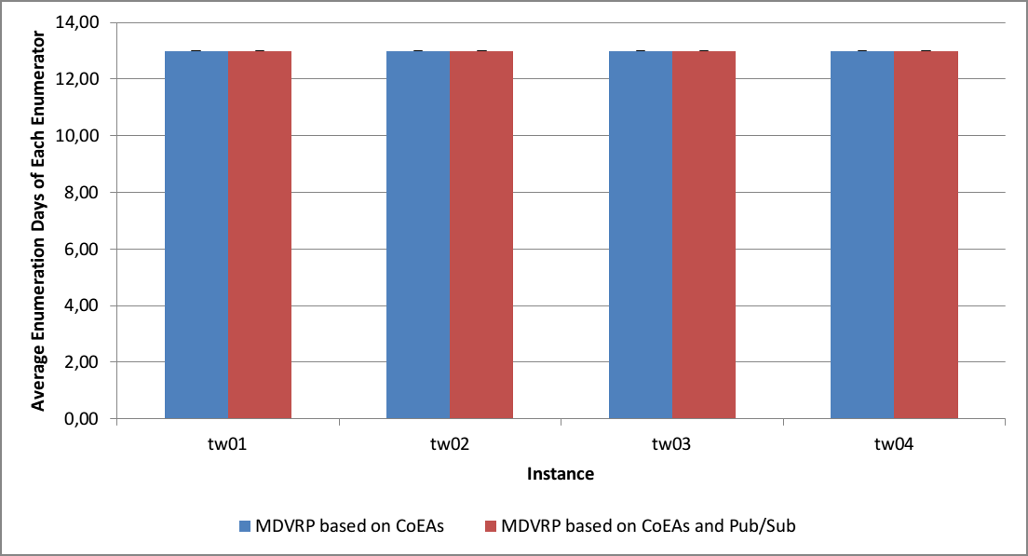

Slide 12
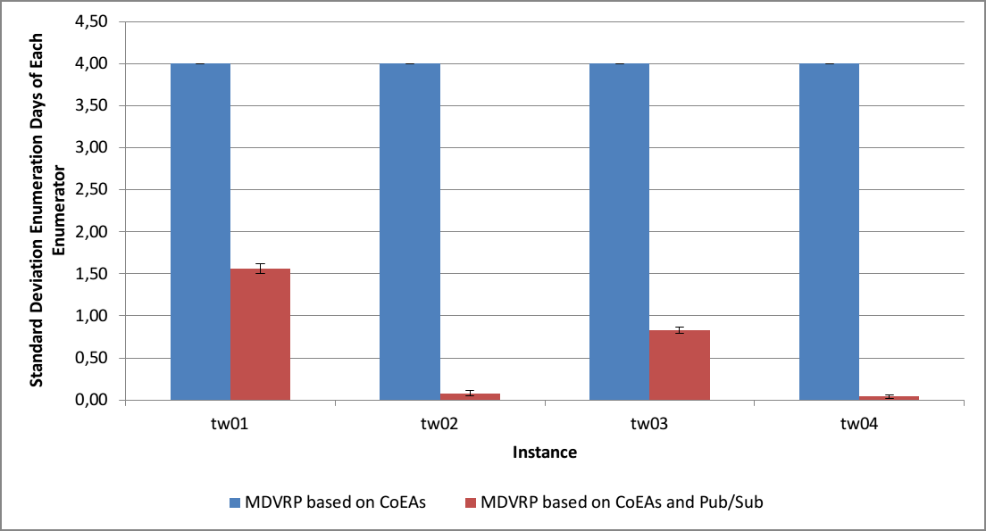

Slide 13
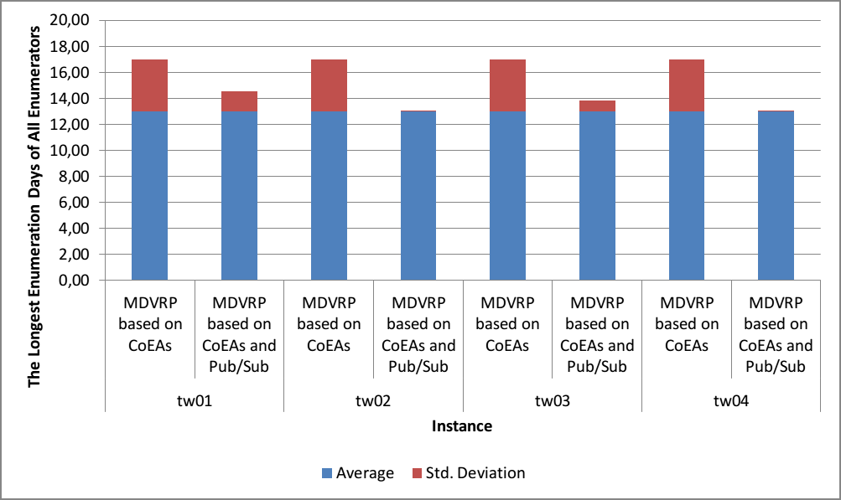

Slide 14
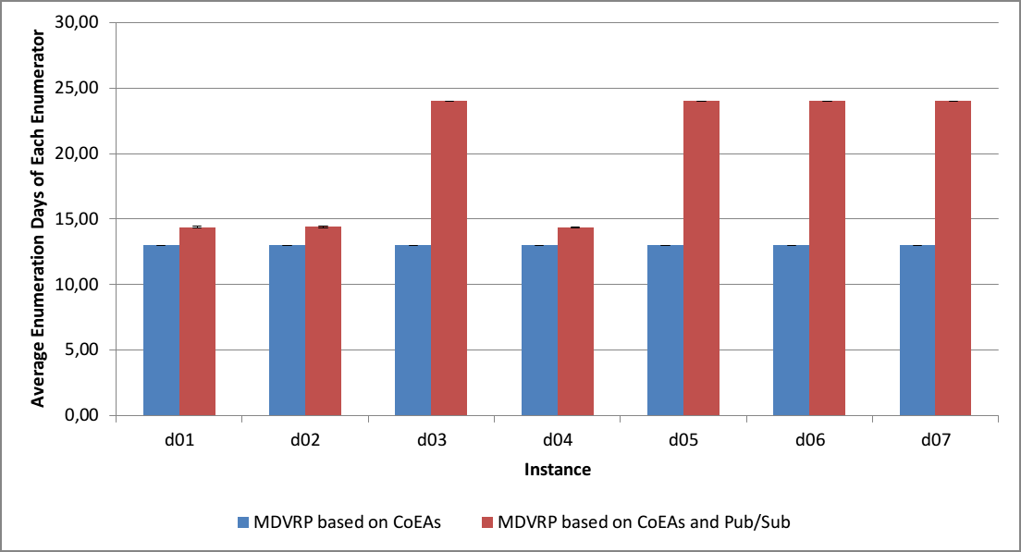

Slide 15
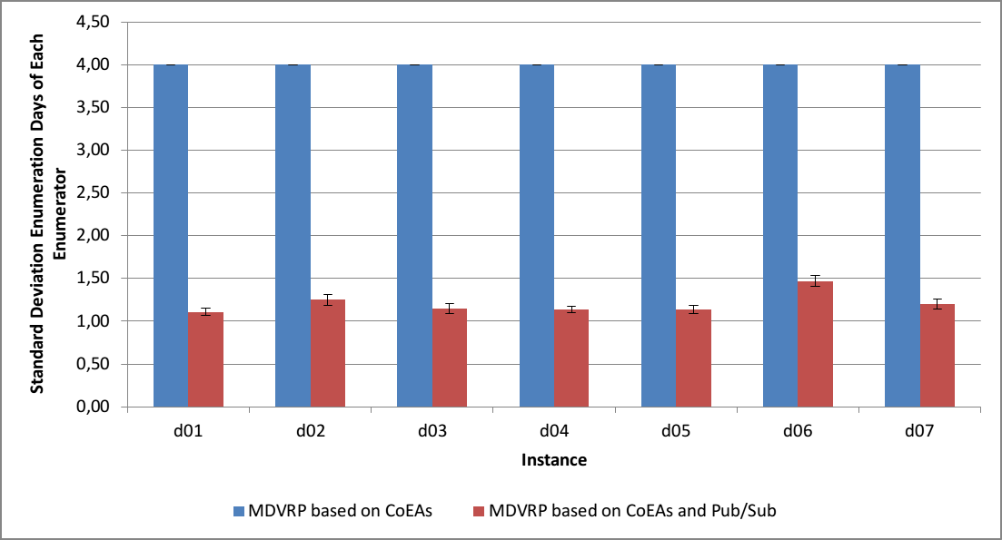

Slide 16
